Slide 1

COLLEGE OF ELECTRICAL AND MECHANICAL ENGINEERING
DEPARTMENT OF SOFTWARE ENGINEERING
FUNDAMENTALS OF PROGRAMMING II PROJECT
PROJECT TITLE = TRAFFIC MANAGEMENT SYSTEM

Slide 2
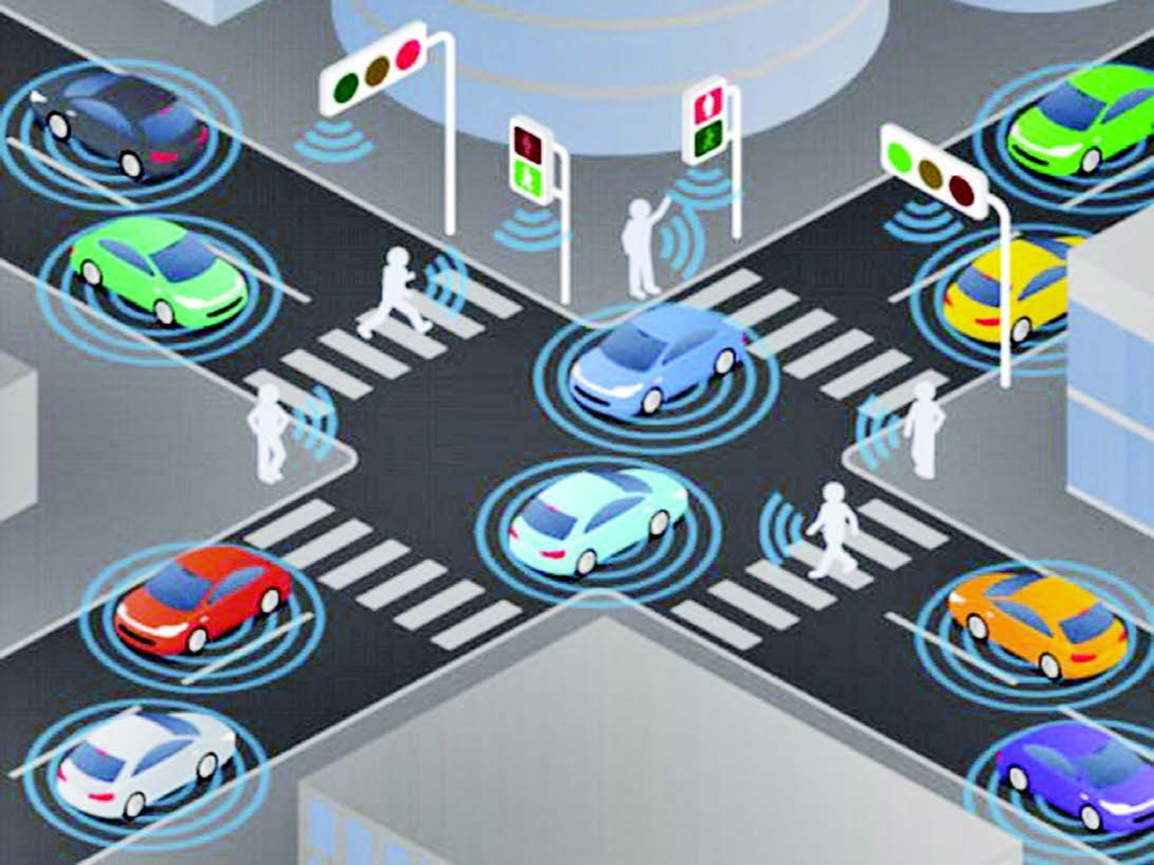
TRAFFIC
MANAGEMENT SYSTEM

Slide 3
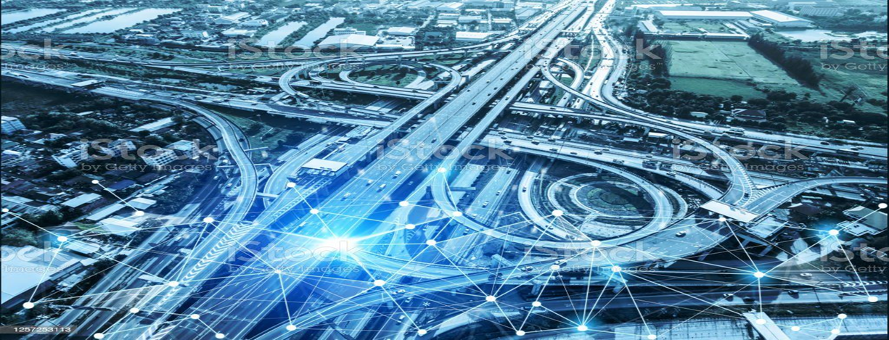
Traffic management system
A traffic management system is a collection of technologies, strategies, and practices designed to monitor, control, and optimize the flow of traffic on road networks and by that our primary goal is to improve traffic efficiency, reduce congestion, enhance safety, and provide a better overall transportation experience for drivers and pedestrians.

Slide 4
Hardware and Software
components of Traffic
Management System are as follows:
Traffic Monitoring
Traffic Signal Control
Incident Detection and Management
Traffic Data Analysis
Traveler Information Systems
Congestion Pricing

Slide 5

Why Implement such a system?
Transportation Efficiency
Intelligent Traffic Systems
Traffic Data Collection
and Analysis
Incident Detection and
Management
User Interfaces and Visualization

Slide 6

Challenges in Traffic Management
Systems
Accuracy of Detection
Sensor Coverage and Reliability
Real-Time Data Availability
Integration of Data Sources
Response Coordination
Privacy and Data Security
Scalability and Adaptability

Slide 7
What to be done?
Typically involves a combination of technologies and processes to identify and respond to incidents on the road network. Here's an overview:
Traffic Flow Data: Real-time traffic flow data, collected from various sources, is analyzed to detect anomalies or disruptions that can indicate incidents.
Traffic Control: Traffic management personnel may be stationed at the incident site or nearby intersections to direct traffic and facilitate the safe movement of vehicles.
Emergency Services: In cases of accidents or medical emergencies, emergency services such as police, fire, or medical personnel are dispatched to provide assistance.

Slide 8
Software Engineering and
Traffic Management System
A software engineer or a programmer can play a crucial role in developing, maintaining,
and enhancing various components of a traffic management system. Some ways are:
System Development
Algorithm Development
Sensor Integration
Real-time Data Processing
User Interfaces and Visualization
Integration with External Systems
Testing and Quality Assurance
System Maintenance and Upgrades

Slide 9
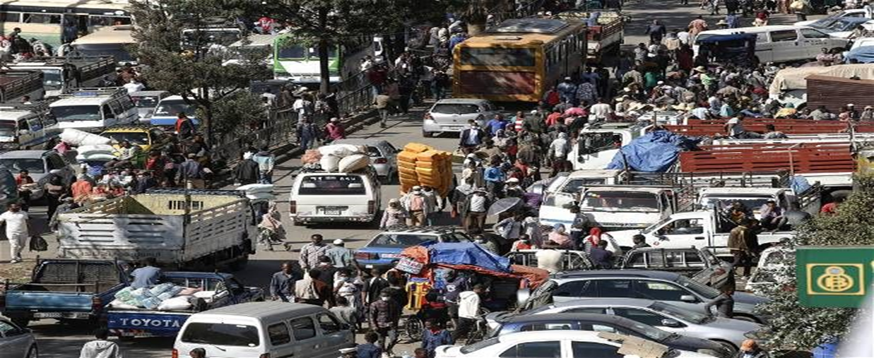
Traffic in Addis Ababa
Addis Ababa experiences traffic congestion and challenges due to its rapidly growing population and limited road infrastructure. The city has witnessed a rise in the number of vehicles on the road, lack of public transportation, driving culture leading to increased traffic volumes and congestion during peak hours.

Slide 10
Traffic Management
System In Addis Ababa
Although it is not too many, not powerful nor effective here are some management system we use in our city:
1. Traffic Signal Control
2. Intelligent Transportation Systems (ITS)
3. Traffic Law Enforcement
4. Public Transportation Development
5. Road Infrastructure Development
6. Traffic Data Collection and Analysis

Slide 11
Problem Statement for traffic
management system.
The existing traffic management system is inadequate in efficiently handling
the increasing volume of vehicles and growing complexities of traffic,
resulting in congestion, delays, and compromised safety.

Slide 12
Problem Statement for traffic management system.
Problem statement on pedestrian movement
Challenges: such as inadequate crosswalks, insufficient signage, and lack of communication with drivers. There is a pressing need for a pedestrian-focused road management system that effectively integrates with traffic control measures, ensuring the safety and ease of movement for pedestrian.

Slide 13
Problem Statement for traffic management system.
Problem statement on Road Management
A Road Management System: that effectively handles traffic flow and ensures the safety and efficiency of vehicles on the road. The system should address a very common challenge such as congestion.

Slide 14
Problem Statement for traffic management system.
Problem statement on Parking Vehicles
The system should be able to handle multiple types of vehicles and provide an organized and user-friendly experience for both the parking attendants and the vehicle owners.
The parking system should have the following features:
1. Vehicle Registration
2. Parking Space Management
3. Parking Allocation
4. Payment Processing
5. Reporting and Analytics

Slide 15
Problem Statement for traffic management system.
Problem statement on Emergency Service
There is a need for a road management system that seamlessly integrates with emergency response services, providing a direct communication channel and facilitating quick and coordinated response in case of emergencies. This system should ensure that emergency services are promptly alerted, enabling them to reach the scene of the incident in the shortest possible time and provide timely assistance to those in need.

